Slide 1


Introduction to
Robotic Process Automation
Title of the Project
Your Register No. 2116220701215
Name : Rajakumaran Bhavanishraj
Guide Name : Dr. Duraimurugan. N
Designation and Department : Associate Professor (SG) Department of Computer Science and Engineering

Slide 2
Abstract
Objective: Automate the process of daily report generation and distribution using RPA
to eliminate manual intervention, ensuring timely and accurate output.
Data Sources & Report Generation: Fetch data from predefined sources
(databases, Excel, CSV) and generate standardized reports (PDF, Excel).
Email Automation: Automatically attach reports to emails and send them to designated
recipients using email clients like Outlook or Gmail.
Benefits: Reduces human error, increases operational efficiency, and enhances
decision-making by automating routine tasks and improving workflow management.

Slide 3
Need for the Proposed System
Eliminates Manual Effort: Automates the creation and distribution of daily reports,
reducing manual workload.
Improved Accuracy: Ensures consistent, error-free reports with automated
data processing.
Timely Distribution: Automatically sends reports to recipients at scheduled times,
ensuring up-to-date information.
Increased Productivity: Frees up time for employees to focus on strategic tasks,
enhancing overall efficiency.
Reduced Operational Costs: Minimizes the costs and time spent on manual report
preparation and distribution.
Scalable and Customizable: Can be applied to various departments and customized
to meet specific reporting needs.

Slide 4
Advantages of the Proposed System
Time Efficiency: Automates routine report generation and distribution, saving time
and allowing employees to focus on more value-added tasks.
Accuracy and Consistency: Reduces human error in report generation, ensuring
accurate and consistent reports are delivered every time.
Cost Savings: Decreases the operational costs associated with manual reporting
tasks, optimizing resource allocation.
Improved Decision-Making: Provides timely and reliable data to decision-makers,
supporting more informed and efficient decision-making.
Scalable Solution: Can be easily scaled to accommodate increasing report volumes
or new departments, offering flexibility as the organization grows.
Enhanced Workflow Automation: Streamlines workflows by automating repetitive
tasks, improving overall operational efficiency and reducing administrative overhead.

Slide 5
Literature Survey
Paper 1: "Robotic Process Automation in Business Operations" by Smith et al. (2020)
Advantages:
Increased Efficiency: Automates repetitive tasks, saving time.
Error Reduction: Ensures consistent and accurate reports.
Disadvantages:
High Setup Costs: Requires significant upfront investment.
Limited Flexibility: Struggles with tasks needing human judgment.
Paper 2: "Data-Driven Automation for Daily Reporting: A Case Study" by Lee & Zhang (2019)
Advantages:
Real-Time Reporting: Provides up-to-date information.
Customizable: Tailors reports for different departments.
Disadvantages:
Data Privacy: Raises concerns with sensitive data.
Scalability Issues: Performance may degrade as data grows.

Slide 6
Main Objective
Automate Report Generation: Develop a system to automatically generate daily
reports by fetching data from predefined sources like databases, Excel, or CSV files.
Streamline Report Distribution: Automate the emailing process, attaching reports,
and sending them to designated recipients at a scheduled time.
Eliminate Manual Intervention: Reduce human effort in creating, processing, and
distributing daily reports, ensuring consistency and accuracy.
Enhance Efficiency: Improve operational efficiency by automating repetitive tasks,
freeing up resources for more strategic activities.
Ensure Timely Delivery: Guarantee that reports are delivered promptly and
consistently to the right recipients at the right time.
Support Multiple Departments: Provide a flexible solution for various departments
(e.g., sales, HR, operations) that require daily or regular reporting.

Slide 7
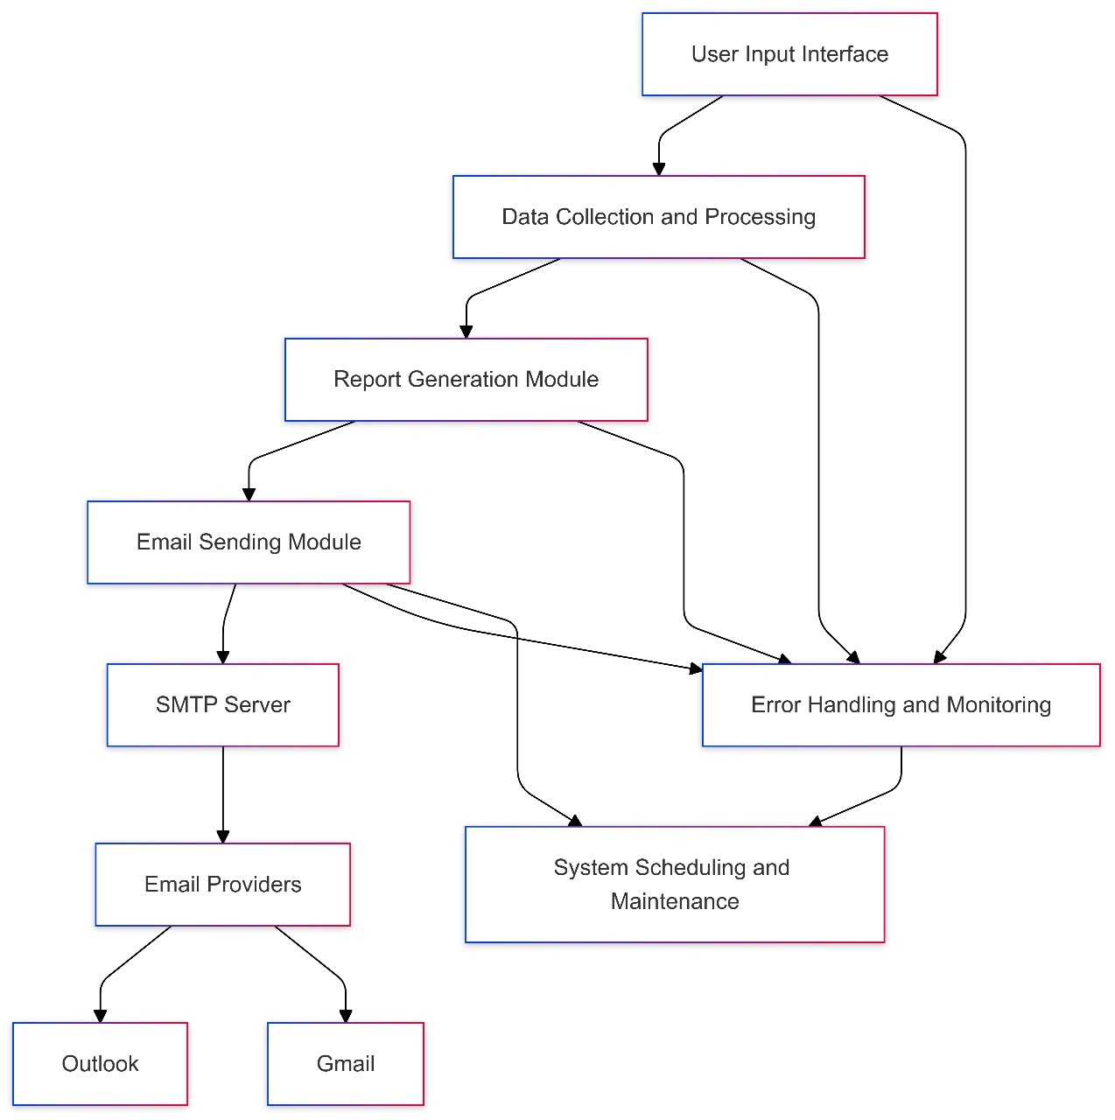
Architecture

Slide 8
System Requirements
Hardware Requirements:
Processor:
  Minimum: Dual-core (2.0 GHz or higher)
RAM:
  Minimum: 4 GB
Storage:
  Minimum: 50 GB free disk space
Network:
  Stable internet connection (10 Mbps or higher)
Software Requirements:
1. Operating System:
  Windows 10 or higher (64-bit)
2. RPA Tool:
  UiPath (or other RPA tools)
3. Email Client:
  Microsoft Outlook or Gmail
4. Data Processing:
  Excel/CSV support

Slide 9
Functional Description
Module 1: Data Collection and Report Generation
Data Fetching: Extracts data from sources like databases, Excel, or CSV files.
Processing: Data is processed (e.g., calculations, filtering) to prepare for reporting.
Report Creation: Generates reports in standardized formats (PDF, Excel) using predefined templates.
Module 2: Email Sending and Distribution
Email Creation: Composes an email with the generated report attached.
Recipient Management: Sends emails to predefined or user-specified recipients.
SMTP Protocol: Uses SMTP to send emails automatically at scheduled times.
Error Handling: Monitors for errors and alerts administrators when issues occur.

Slide 10
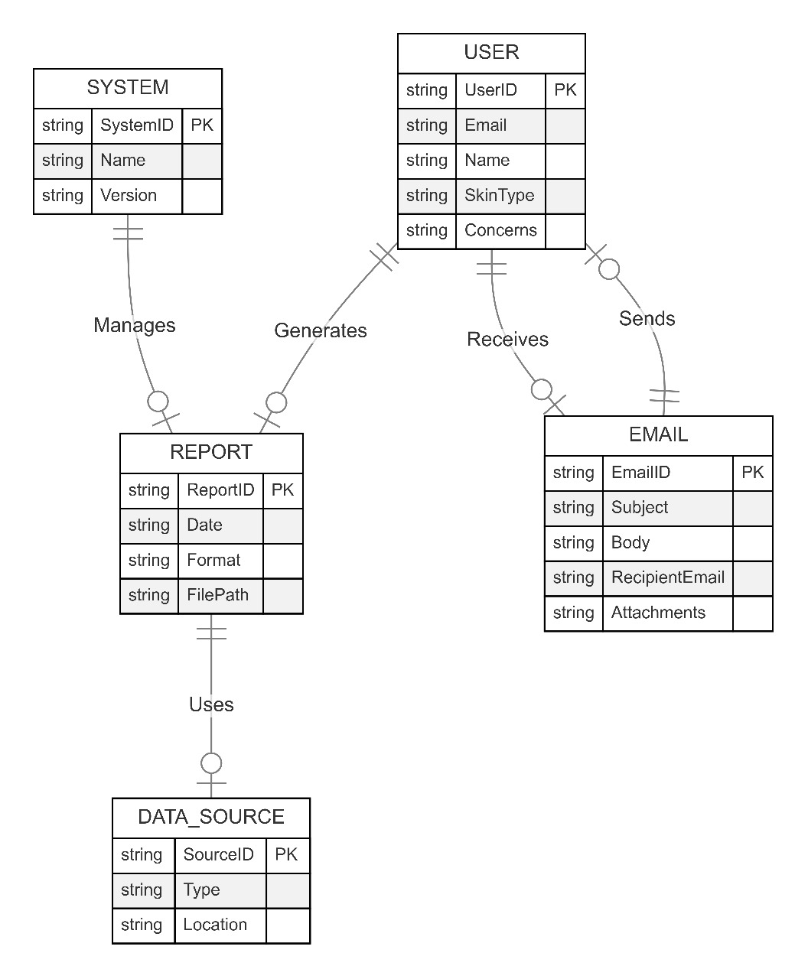
Table Design

Slide 11
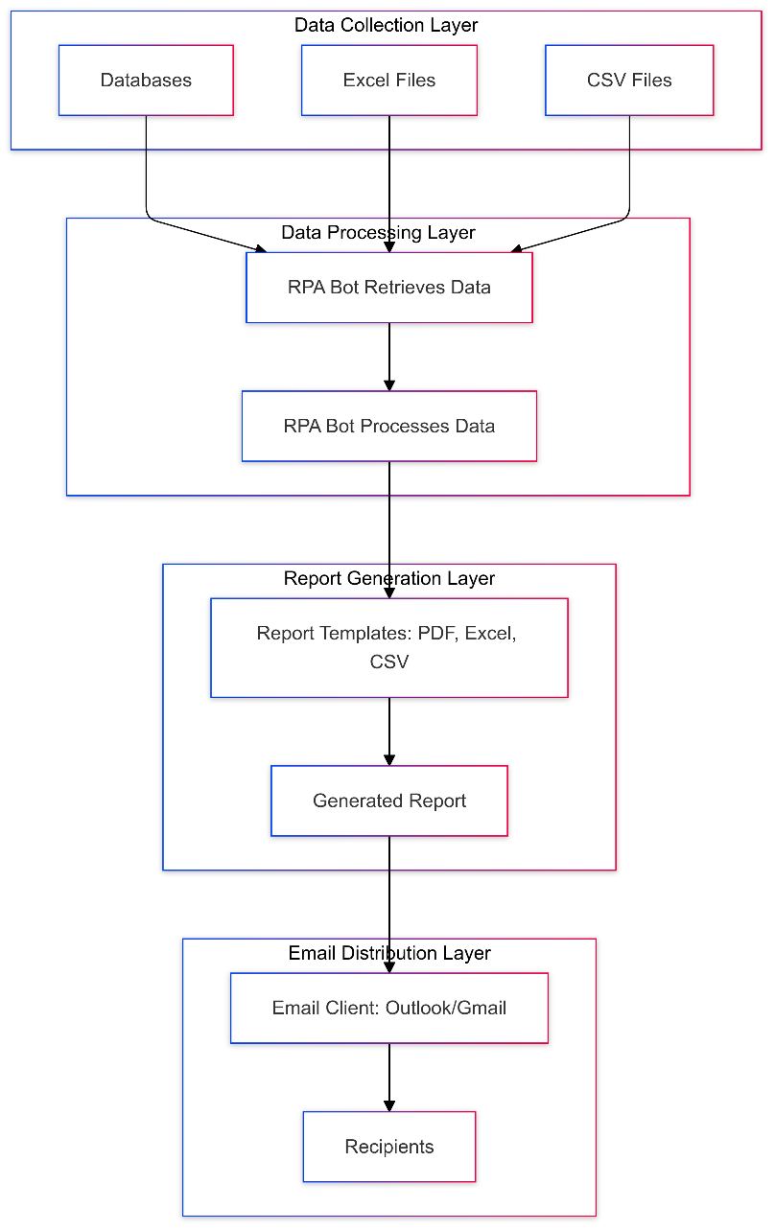
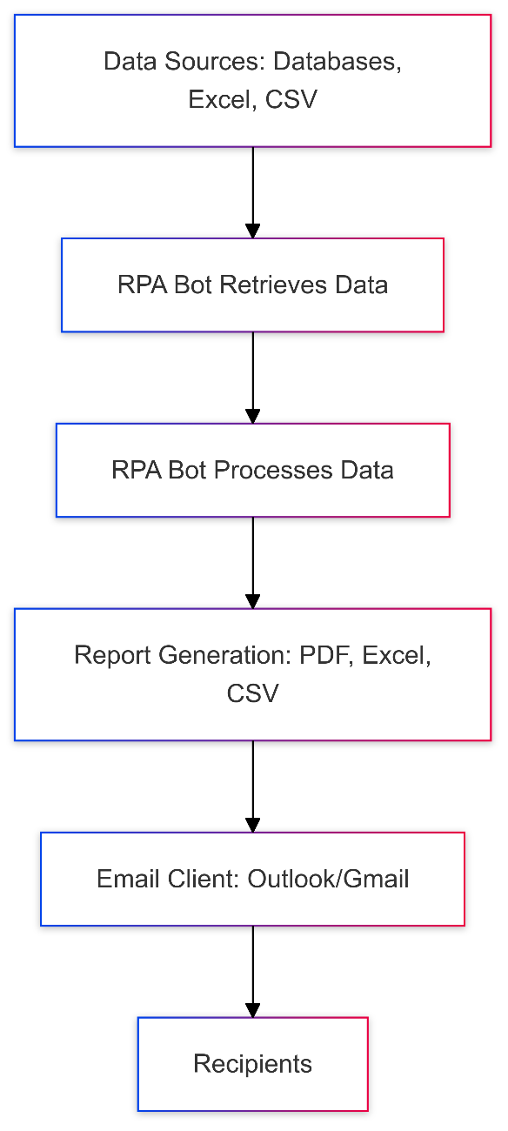
Process Design

Slide 12
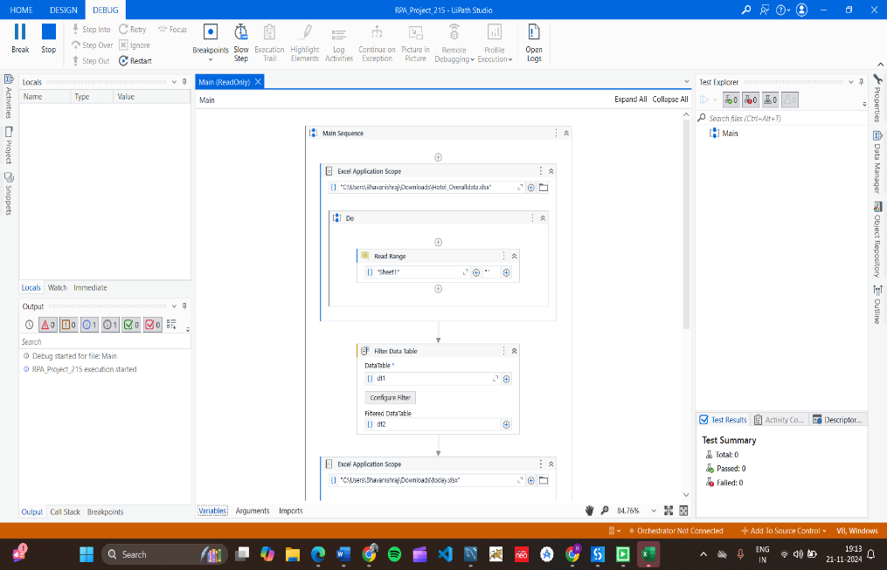
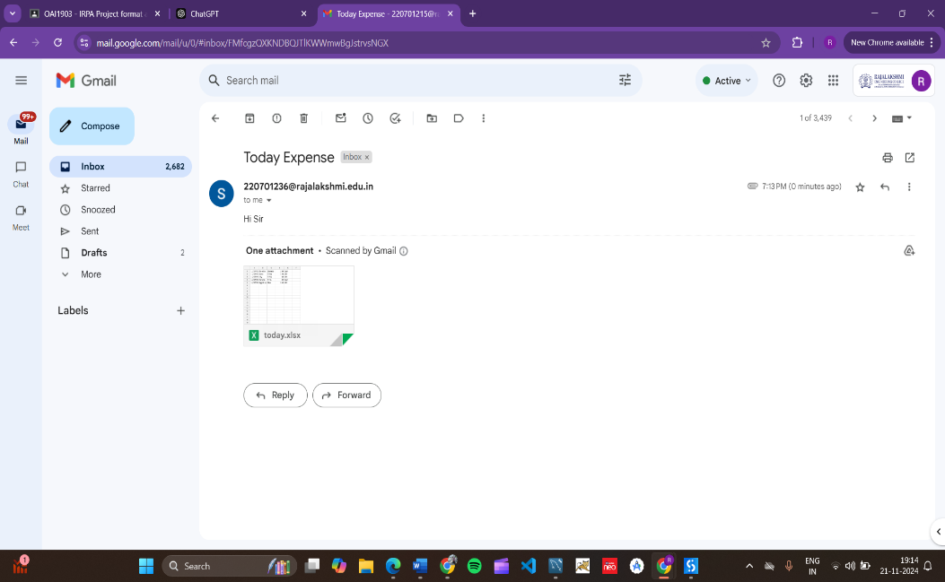
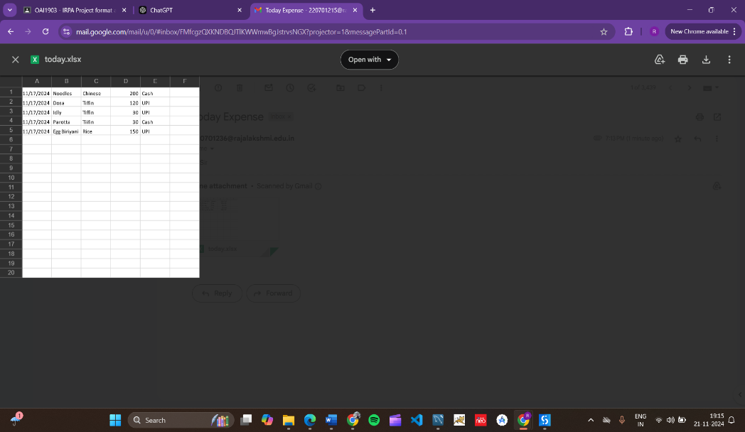
Implementation
The Workflow is executed and now the original data is
filtered into another excel based on the given criteria.
The generated report is mailed to the recipient using the
SMTP Activity.
→ The report is now sent to the recipient with the excel.

Slide 13
Conclusions
Error Minimization: Reduces human errors by automating data entry and report
creation, improving accuracy.
Increased Productivity: Frees up employees from repetitive tasks, allowing them to
focus on more critical activities.
Scalability: The solution is adaptable for different departments and industries,
supporting various report generation needs.
Automation Efficiency: RPA eliminates manual work in report generation,
ensuring consistent, timely, and accurate reports.
Timely Delivery: Automated report distribution ensures timely delivery to the rig

Slide 14
Future Enhancement
Integration with AI for Personalized Reports
The system can be enhanced by incorporating AI and machine learning to analyze past
reports and personalize the content based on the recipient’s preferences or history.
This would improve the relevance of the information sent, making reports more
actionable for the recipients. By analyzing data trends, AI could recommend specific
actions or adjustments for business processes, thereby enhancing decision-making.
Furthermore, it could optimize email content to cater to specific roles within the
organization, providing tailored insights for executives, managers, or departments.
-Integration with Cloud Storage Solutions
A future enhancement would involve integrating the system with cloud storage solutions such
as Google Drive, Dropbox, or OneDrive. This would enable the bot to store the generated
reports in cloud storage, providing recipients with the option to access the report at any time,
even after the email has been sent. Additionally, cloud integration would enable greater
collaboration, as team members could edit, comment, and update reports directly in the cloud,
ensuring that all parties are working with the most up-to-date information.

Slide 15
IEEE Paper
"Email Robot Tutorial - Automate Sending Emails“ - Author(s): UiPath Team
"Automate Email Processing with RPA“ - Author(s): Richard Schoen (Fortra)
"Intelligent Email Processing using Robotic Process Automation“
- Author(s): IEEE Research Team
"Automation of Report Generation and Distribution in RPA“ –
Author(s): IEEE Research Team
"Process Automation for Email-based Data Entry and Report Management"
Author(s): IEEE Research Team

Slide 16
References
"Use of RPA for Email Automation with Salesforce Integration"
Discusses automating email communications through RPA integration with platforms
like Salesforce, aligning with daily report automation.
"Implementation of Robotic Process Automation (RPA) in Digital Marketing"
Explores how RPA streamlines repetitive tasks, which can be applied to automate
report generation and email distribution.
"E-Mail Assistant – Automation of E-Mail Handling and Management using RPA"
Focuses on automating email tasks like drafting and sending reports via RPA.
"Robotic Process Automation: In-Depth Analysis of Advanced Automation
Techniques and Technologies"
Provides an overview of RPA technologies applicable to automating tasks like
report generation.

Slide 17
Queries

Slide 18
Demonstration

Slide 19
Thank You

